Slide 1
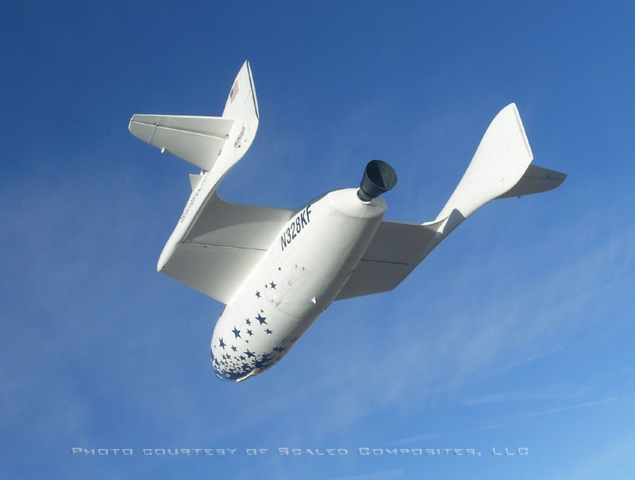
VIII. Consequences of usual approximations
Notes:
In the previous sections, flight mechanics equations have be written with a set of usual approximations.
Those approximations may usually considered as valid for slow airplane, but need to be evaluated for airplanes flying at high speeds and/or high altitudes. They also need to be evaluated when a precise evaluation of cruise performance is needed.
Illustration : Scaled composites « Spaceship 1 » in glide after a suborbital flight.

Slide 2
1. Usual approximations
In the previous sections of this course, several approximations have been used :
  Gravity acceleration « g » constant and equal to g₀ (9.80665 m/s²)
  Gx₀y₀z₀ is considered as a Galilean reference system (« flat earth approximation »)
  Buoyancy is neglected
Notes:
When writing the expressions for forces equations, we have assumed that :
Gravity acceleration « g » is considered as constant
Gx₀y₀z₀ is a Galilean reference system, expressing the acceleration vector in this reference system, thus neglecting acceleration terms corresponding to centripetal acceleration and Coriolis acceleration.
Buoyancy is neglected.

Slide 3
2. « g » variations with altitude and latitude
Usual value retained for gravity acceleration (g) is :
g₀ = 9.80665 m/s² (or 9.81 m/s²)
This constant value does not account for g variations with altitude and latitude.
Example : At 0° latitude (equator) and
40 000 ft geometric altitude (12.2 km)
g = 9.74 m/s2 (-0.65 %)
Notes:
Gravity acceleration g is a function of latitude, noted λ, and geometric altitude, noted z.
At sea level, g is given by Lambert’s equation :
g(λ,0) = g₀ {1 – 2.6373 10⁻³ cos (2λ) + 5.9 10⁻⁶ cos²(2λ)}
Taking into account centrifugal acceleration, the expression for g at geometric altitude z is :
R(λ) is earth radius at latitude λ :
a is earth radius at equator and b is earth radius at poles.
(a = 6378.2 km and b = 6356.8 km)

Slide 4
2. « g » variations with altitude and latitude
Δg/g₀
0.4%
0.2%
0.0%
90° latitude (poles)
0
10000
20000
30000
40000
50000
60000
-0.2%
-0.4%
0° latitude (equator)
45° latitude
-0.6%
-0.8%
-1.0%
Geopotential altitude H(ft)
Notes:
This figure presents the value of gravity acceleration (« g ») as a function of geopotential altitude, for three latitudes (0°, 45° and 90°).
On the figure, gravity acceleration is presented relative to the reference value for ISA, g₀ :
g(λ, H) = g₀ + Δ g(λ, H)
At usual cruising altitudes for commercial airplanes (35 000 ft), the order of magnitude for Δ g is 0.3 % at 45° latitude.

Slide 5
3. « Flat earth » approximation
When flying at constant altitude :
  Trajectory is curved due to earth curvature : relative acceleration has to be taken into account
  A Coriolis acceleration due to relative movement of airplane and earth develops
Neglected terms may be expressed as an additional load factor Δn :
( n + Δn) mg + Ra + F = 0
Notes:
When writing the expressions for forces equations, we have assumed that Gx₀y₀z₀ is a Galilean system.
This is equivalent to the « flat earth » approximation : when an aircraft is flying in straight and level flight, we neglect the influence of earth curvature and rotation.
In reality, when flying at constant altitude, the aircraft trajectory is curved and there is a normal acceleration due to this curvature. For accurate performance computation, we need to take into account, the effect of relative acceleration due to aircraft movement. It must be stressed that the normal acceleration due to earth rotation is included in « g ».
We need also to take into account a « Coriolis » acceleration term due to influence of earth rotation.
The neglected terms may be expressed as an additional load factor vector, in order to evaluate its order of magnitude which may vary according to aircraft characteristics and flight conditions.

Slide 6
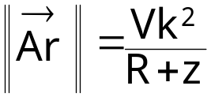
3. « Flat earth » approximation
Relative acceleration
Incremental load factor
in horizontal flight
(i.e. constant geometric altitude) :
Δn_{z} = - Vk²
g(R+z)
Vk
Ar
z₀
R + z
R
Numerical value for Vk 500 kt and Z 11 km :
Δn_{z} = - 0.1 10⁻²
Notes:
In horizontal flight at constant geometric altitude z, the trajectory is circular due to earth rotundity. Trajectory radius is R + z, where R is the earth radius, which is a function of latitude λ.
The relative acceleration, or centripetal acceleration, is :
In horizontal flight, the corresponding load factor increment is vertical (Δn_{x} = Δn_{y} = 0) :
Orders of magnitude for Δn_{z} are presented below :

Slide 7
3. « Flat earth » approximation
Coriolis acceleration
z_{abs}
x₀
Coriolis acceleration :
Ac = 2 Ω₀ ∧ Vk
y₀
G
Ω₀
z₀
Coriolis acceleration is :
  Proportional to ground speed
  Normal to velocity vector
  Normal to pole axis
O
y_{abs}
x_{abs}
Consequence : Δn_{z} = - 2 Ω₀ Vk sinχ_{k} cosλ
g
Numerical value for Vk 500 kt, 45 ° latitude,
χ_{k} 90° (eastbound track) : Δn_{z} = - 0.27 10⁻²
Notes:
The earth rotates around polar axis at an angular rate Ω₀ (7.29212 10-5 rd/s), corresponding to one revolution in 23 hours 56 minutes and 4 seconds. There are two consequences :
A centrifugal acceleration component, opposed to the gravitation, which is included in the gravity acceleration « g ».
Coriolis acceleration which is neglected when considering the earth reference system as a Galilean reference system.
Coriolis acceleration is :
In earth reference system Gx₀y₀z₀ , rotation vector coordinates are :
n straight horizontal flight (γ_{k} = μ_{k} = 0), after transfer to kinetic reference system, the load factor increment due Coriolis acceleration is :
The normal component Δn_{z} (Δn_{y} has no significant impact on performance) is maximal at equator (λ = 0) with a westbound track (χ_{k} = 270°), it is negative (positive impact on performance) when the track to the east (χ_{k} = 90°).

Slide 8
3. « Flat earth » approximation
Coriolis and relative accelerations
numerical values for 45° latitude, 40 000 ft
0.01
χ_{k} 270°
0.00
0
0.5
1
1.5
2
2.5
3
Δn_{z}
χ_{k} 360°
-0.01
True track χ_{k} 90°
-0.02
-0.03
Mach
Notes:
This figure presents the numerical values for the addition of relative acceleration and Coriolis acceleration at 40 000 ft (in ISA conditions) and 45° latitude.
For subsonic airplanes, the numerical values for those accelerations is lower than 0.005 g (in absolute values), but may exceed 0.02 g at Mach 2.
Northbound (true track 360°) or southbound, the Coriolis acceleration is zero and the numerical values are those for relative acceleration (which does not depend on latitude).
Coriolis acceleration has a positive effect on performance on an eastbound track (90°), since it is equivalent to a decrease in normal load factor, and a negative effect on a westbound track.

Slide 9
4. Influence of buoyancy
Buoyancy
A balloon is lifted by buoyancy :
B = mg
B is the buoyancy :
B = (ρ_{air} - ρ_{gas})V_{gas}
ρ_{gas} is the gas density
V_{gas} is the volume of gas contained in the envelope
B
mg
Weight
For a « heavier than air » aircraft, buoyancy is usually neglected.
Notes:
Balloons (lighter than the air vehicles) rely on buoyancy instead of lift. Balloons have been the first flying vehicles in history. The balloon envelope may be filled with a light gas such as helium or hydrogen (helium is preferred since hydrogen burns in contact with the air oxygen), or with hot air (warmed by a burner).
In the case of airplanes, buoyancy is usually neglected, but it must be stressed that :
On ground, the air contained in the airplane is not weighted (it is balanced by buoyancy).
If an airplane is not pressurized, this means that the mass of air is always balanced by buoyancy, and, in straight and level flight (n_{z}= 1), the buoyancy has no impact on lift equation.
However, the mass of air contained in the airplane, which is not weighted, needs to be accelerated.
When an airplane is pressurized, this means that, in level flight, the difference of air density between external air and pressurized air needs to be taken into account, as an additional mass, not balanced by buoyancy, which requires additional lift.

Slide 10
4. Influence of buoyancy
Usually, buoyancy and mass of air contained in the airplane are neglected :
(m + Δm_{a})g n - ρ V_{A/C} g + Σ F_{ext} = mg (n + Δn) + Σ F_{ext} = 0
  The mass of air in the aircraft is : Δm_{a} = ρ V_{A/C} + (ρ_{pr} - ρ) V_{pr}
  V_{A/C} is the airplane volume,
  V_{pr} is the pressurized volume,
  ρ_{pr} is the pressurized air density
For an non pressurized A/C, in straight steady flight : Δn = 0
Orders of magnitude for a wide body transport : Acceleration at take-off : Δnx = 0.005
Cruise at FL350 : Δnz = 0.003
Notes:
When mass of air contained inside the airplane, and buoyancy is accounted for, the expression for incremental load factor is :
In aerodynamic reference system, the components of incremental load factor due to buoyancy is :
In straight steady flight :
If the airplane is not pressurized : Δm_{a} = ρV_{A/C}
As a consequence, for a non pressurized airplane in steady flight, the incremental load factor due to buoyancy is zero.
Influence of buoyancy is usually negligible but may become significant in the case of wide body airplanes which have a higher volume to mass ratio.

